Slide 1



NETFLIX
DATA ANALYSIS USING SQL
Play
-Kothapally Keerthana

Slide 2

Table of Contents
01
02
03
Project Introduction & Dataset
Data Analysis Using SQL
Key Insights & Conclusion

Slide 3
01
Project Introduction & Dataset Overview
This dataset from Kaggle includes all Movies and TV Shows available on Netflix.
It covers key info like:
Title, Type (Movie/TV Show)
Director, Cast, Country
Date Added, Release Year
Rating, Duration, Genres
Dataset Link: Movies Dataset
Goal: Use SQL to analyze trends and gain business insights

Slide 4
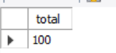
02
How many total titles are there?
SELECT COUNT(*) as total FROM netflix_titles;

Slide 5
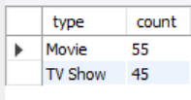
What percentage of the dataset is Movies vs TV Shows?
SELECT type, COUNT(*) as count FROM netflix_titles GROUP BY type;
Insight:Netflix has significantly more Movies than TV Shows

Slide 6
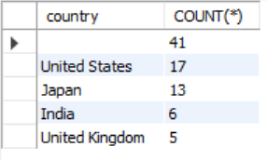
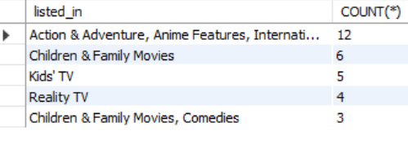
Top Countries & Genres
SELECT country, COUNT(*) FROM netflix_titles GROUP BY country ORDER BY COUNT(*) DESC LIMIT 5;
SELECT listed_in, COUNT(*) FROM netflix_titles GROUP BY listed_in ORDER BY COUNT(*) DESC LIMIT 5;
Insight:
USA leads in content; Adventure,Anime and International Movies are most common

Slide 7
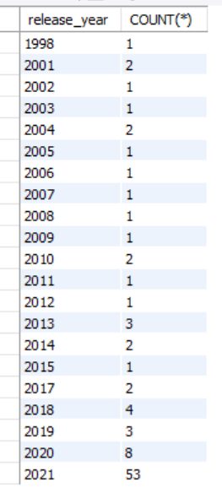
How has Netflix's content production changed over the years?
SELECT release_year, COUNT(*) FROM netflix_titles GROUP BY release_year ORDER BY release_year;

Slide 8
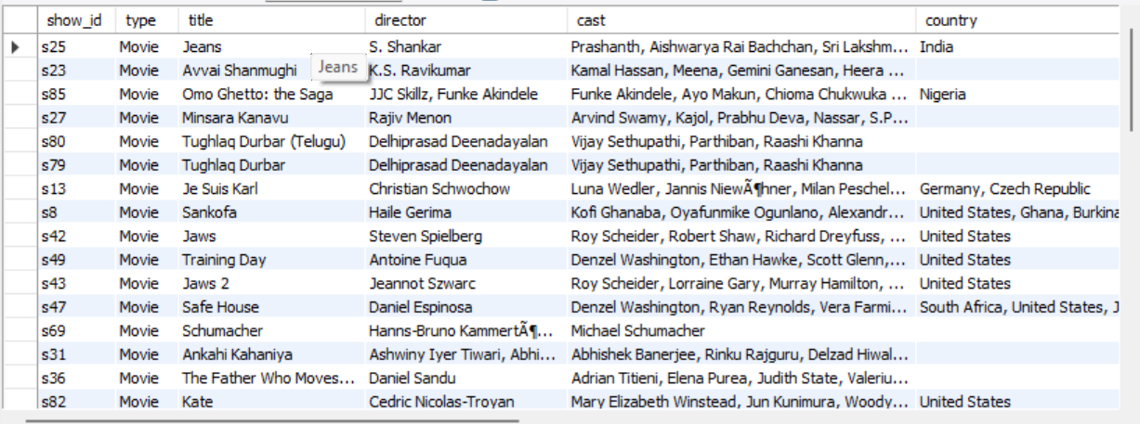
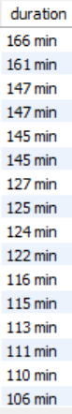
Identify the Longest Movie
SELECT
*
FROM netflix.netflix_titles
WHERE type = 'Movie'
AND duration IS NOT NULL
ORDER BY CAST(SUBSTRING_INDEX(duration, ' ', 1) AS UNSIGNED) DESC;

Slide 9
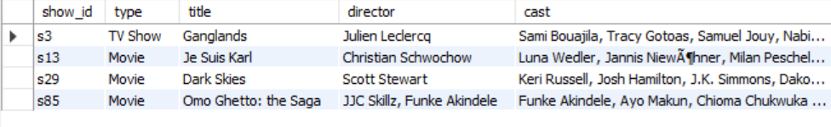
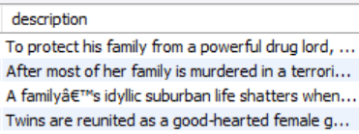
Query to find all titles where the description contains word family
SELECT * FROM netflix_titles where description LIKE ‘%family%’;

Slide 10
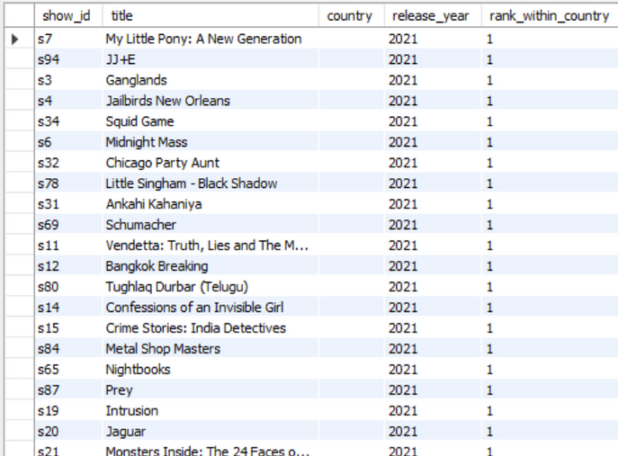
Rank movie and TV show titles based on their release year within each country. Provide the title name, release year, country, and rank within the country.
SELECT show_id, title, country, release_year,
RANK() OVER (PARTITION BY country ORDER BY release_year DESC) AS rank_within_country
FROM netflix;

Slide 11
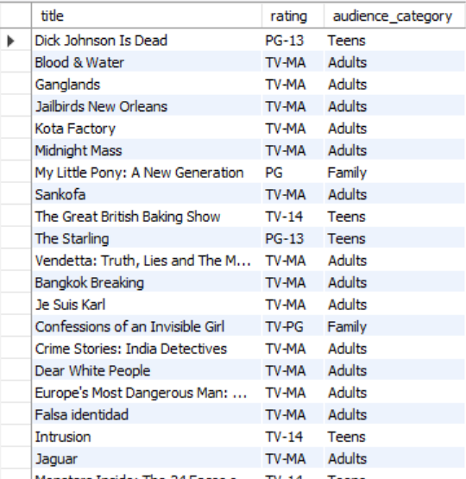
Classify Netflix titles into audience categories (Kids, Family, Teens, Adults) based on their maturity rating.
SELECT title, rating,
CASE
WHEN rating IN ('TV-Y', 'TV-Y7', 'G', 'TV-G') THEN 'Kids'
WHEN rating IN ('PG', 'TV-PG') THEN 'Family'
WHEN rating IN ('PG-13', 'TV-14') THEN 'Teens'
WHEN rating IN ('R', 'TV-MA', 'NC-17') THEN 'Adults'
ELSE 'Unknown'
END AS audience_category
FROM netflix_titles;

Slide 12
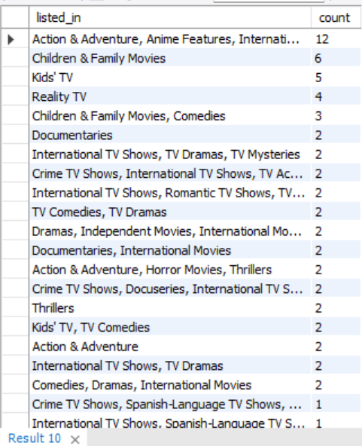
How many Netflix titles belong to each genre or genre combination
SELECT listed_in, COUNT(*) AS count
FROM netflix_titles
GROUP BY listed_in
ORDER BY count DESC;

Slide 13

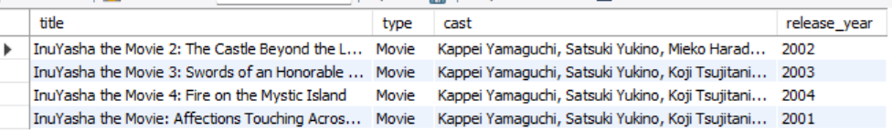
Retrieve titles featuring a specific actor using a stored procedure
DELIMITER $$
CREATE PROCEDURE GetTitlesByActor(IN actor_name VARCHAR(255))
BEGIN
SELECT title, type, cast, release_year FROM netflix_titles WHERE FIND_IN_SET(actor_name, cast) > 0;
END $$
DELIMITER ;
CALL GetTitlesByActor('Kappei Yamaguchi');

Slide 14
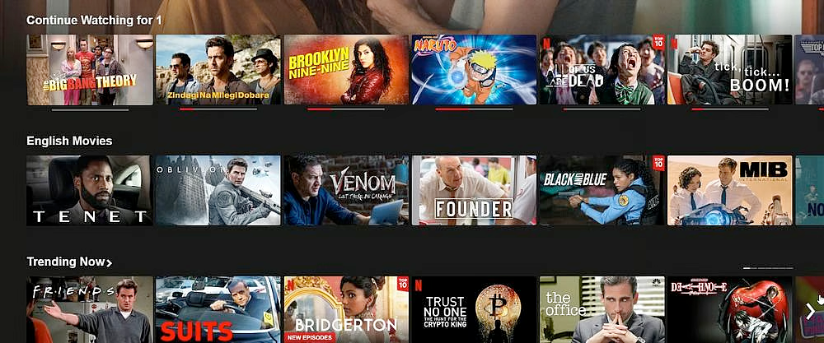
Business Insights from SQL Analysis
Optimize Content: Identify top genres and regions to guide content investment.
Improve Retention: Analyze user behavior to reduce churn.
Target Marketing: Personalize campaigns with SQL-driven audience insights.
Fuel Growth: Use subscription trends to refine pricing and expand markets.

Slide 15
Conclusion
SQL enabled effective extraction of real-world insights from Netflix’s structured dataset
Analysis revealed trends in regional content dominance, popular genres, and content release patterns
These insights can inform content strategy, audience targeting, and platform decisions
Tools Used:
SQL (for querying),Kaggle (for data source),Canva(ppt)

Slide 16


